Slide 1
Cleared for Takeoff: Strengthening Emergency Preparedness in Rural, Multicultural Communities
Presented by: Traci Boyl, Emergency Management Coordinator, City of Ukiah

Slide 2
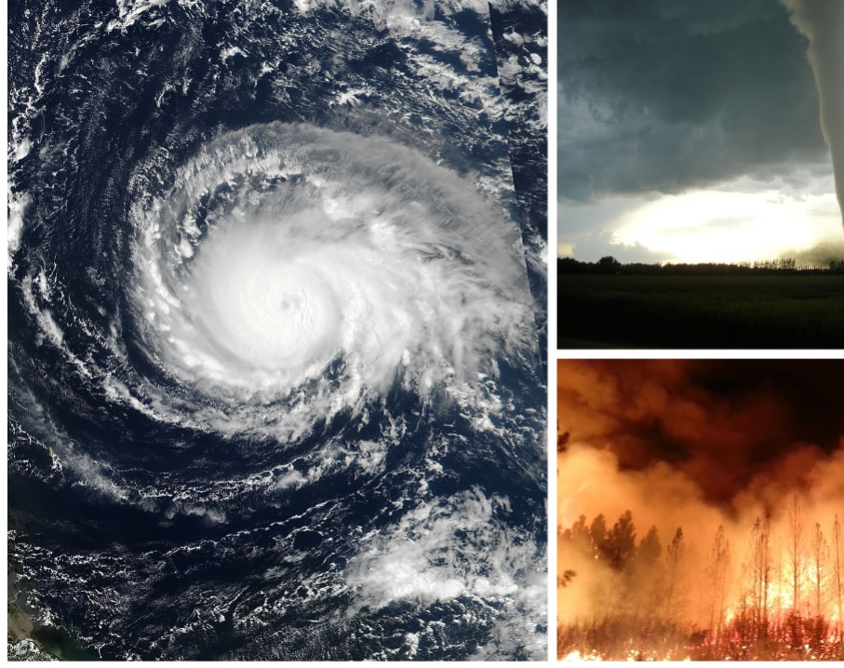
Disaster Strikes – You can only keep one tool, piece of knowledge, or resource, what is it?
Notes:
Before we go any further—take a second to pick up the Silly Putty in front of you. It’s not just a fidget toy—though feel free to use it for that too! Silly Putty represents one of the most critical traits in emergency preparedness, especially for small, rural communities: flexibility. When the plan breaks down, when the resources fall through, when the unexpected hits—it’s our ability to stretch, adapt, and reshape that makes the difference. So think about your own community—what areas feel rigid, and where can we introduce more flexibility?

Slide 3
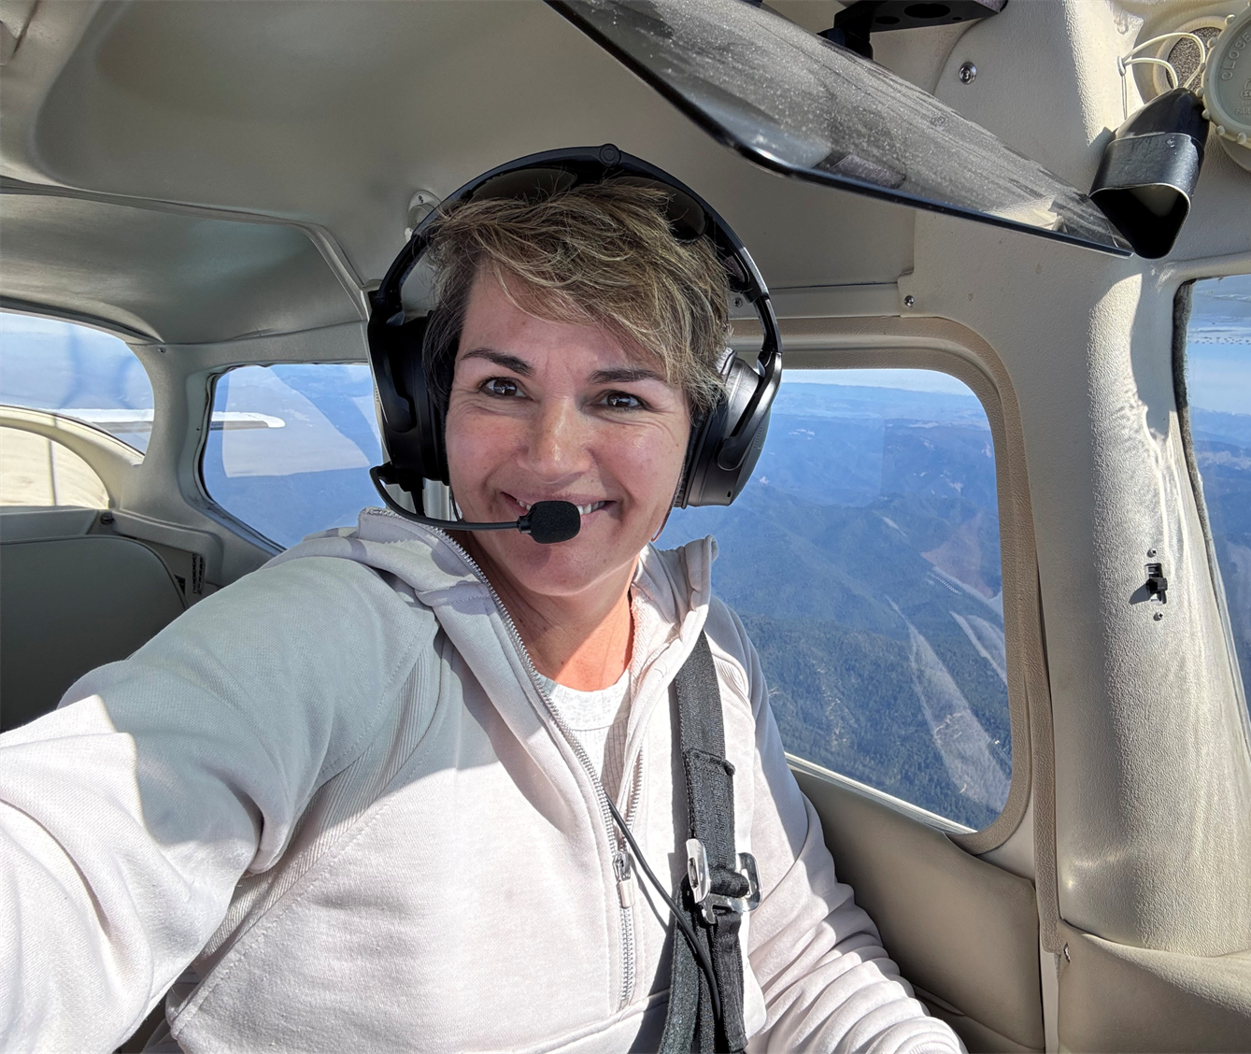
Meet Your Presenter: Traci Boyl
Private pilot and Airplane Owner
Senior Management Analyst and Emergency Coordinator
Former firefighter with experience in disaster response & recovery
Mother, grandmother, outdoor adventurer & runner
Small business owner and aspiring author
Notes:
Before we dive in, I want to share a little about myself—not to focus on me, but so you know where I’m coming from.
I'm a senior management analyst and emergency coordinator, a former firefighter, and a private pilot. I've led wildfire recovery, worked in homeless services, and run nonprofit disaster case management programs.
All of those experiences shape how I approach community resilience today. I’m also a mom, grandma, and small business owner—so I understand what it means to juggle priorities while still showing up for your community.

Slide 4
AGENDA
Welcome and Introduction
Understanding Your Community
Lessons from the Field
Innovative Tools and Strategies
AI as Co-Pilot
Direct Approach to Solutions
Key Takeaways & Actionable Strategies
Final Approach: Q&A and Discussion
Notes:
Here’s what our journey looks like today: We’ll start by understanding who’s in the room and what your communities are dealing with.
Then we’ll dive into lessons from the field—both national and local—and look at practical, innovative tools and approaches.
From AI to partnerships, and sticky notes to storytelling, we’ll keep things interactive and grounded in reality.
We'll wrap up with concrete takeaways and time for discussion—so you leave with something useful.

Slide 5
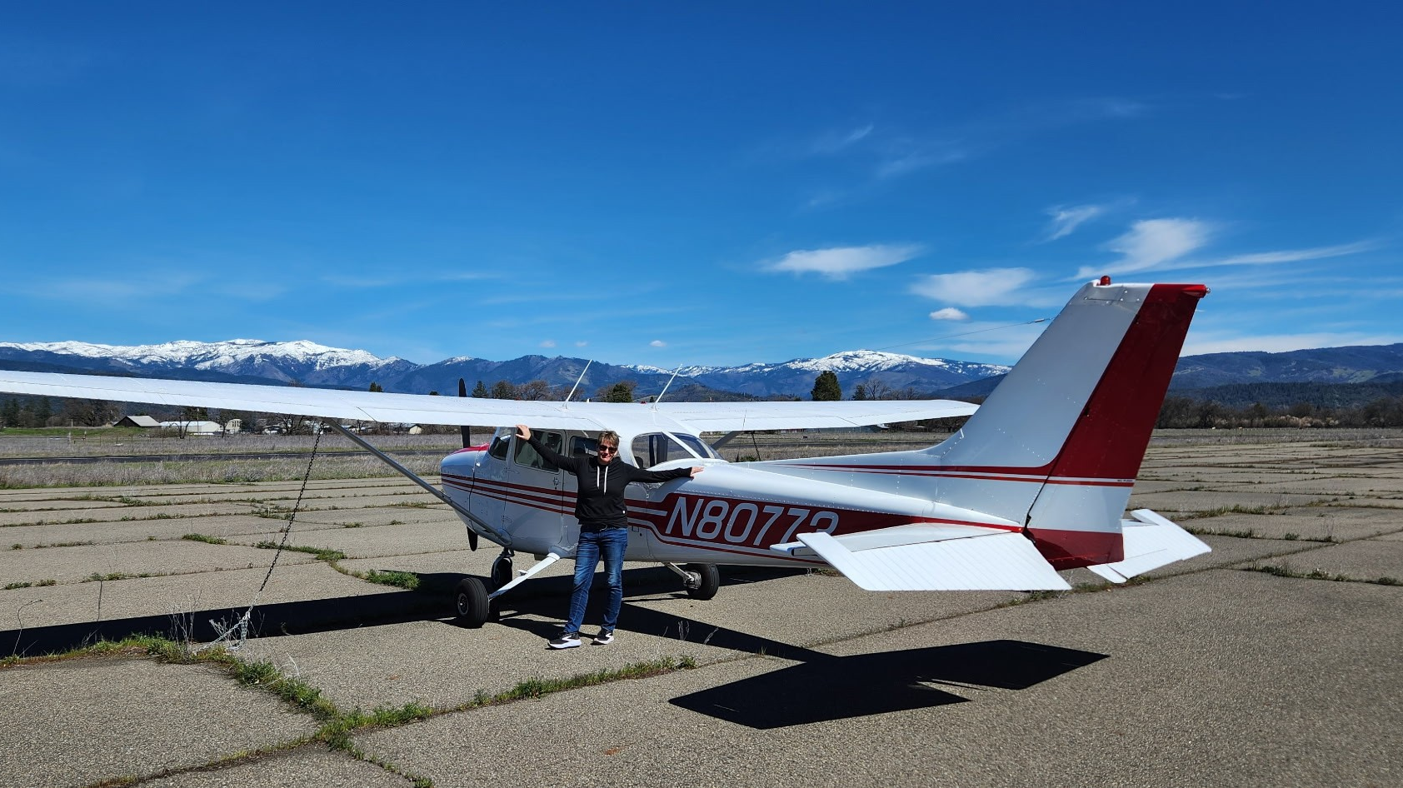
And aviation too!
Notes:
You might be wondering—what does aviation have to do with emergency management?
Well, as a pilot, I rely on checklists, coordination, preparation, and split-second decisions under pressure—sound familiar?
We’ll draw a few parallels as we go: from flight planning to managing emergencies, it’s all about having the right tools and mindset before you hit turbulence.

Slide 6
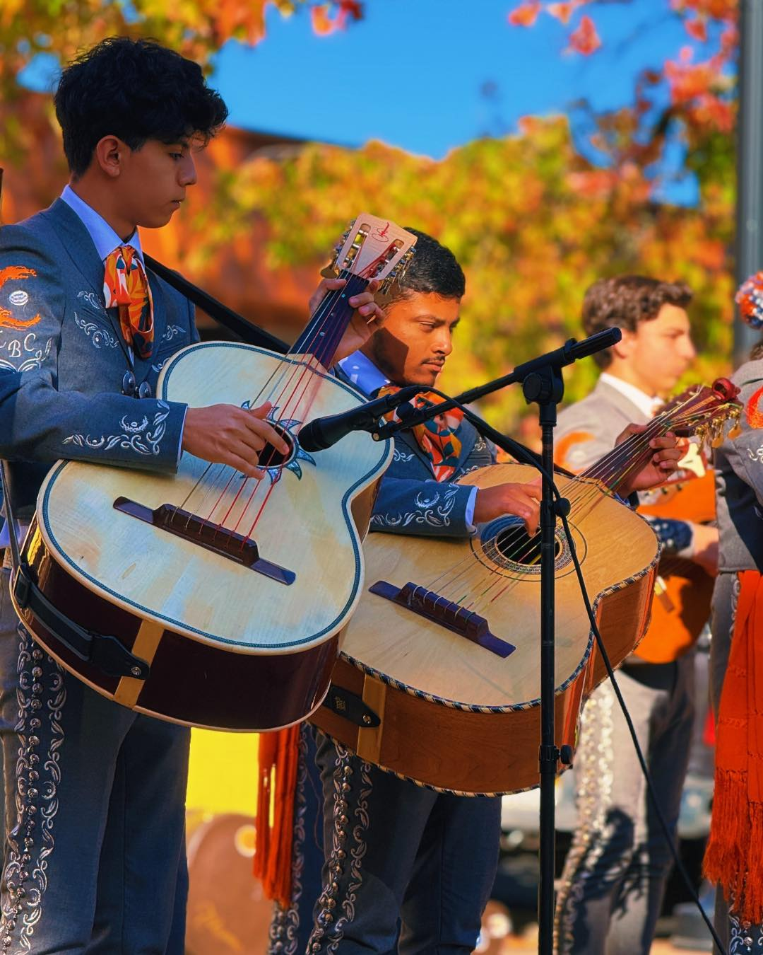
Pre-Planning Checklist: Understanding Rural Multicultural Communities
Limited resources in rural areas
Cultural and language barriers in diverse populations
Vulnerability to climate events, wildfires, and other disaster
Notes:
I’d love to hear from you—what are the biggest challenges you face in your community when it comes to preparedness and response? Maybe it's communication with non-English speakers, maybe it's resource shortages, maybe it’s apathy or burnout. In Ukiah, we’ve seen everything from power shutoffs to wildfires to entire neighborhoods with no cell service for days. These things reveal where our systems are strong—and where they’re not. So take a moment—think about your most pressing challenge, and feel free to share it with your table or the group. We'll use some of your input in our upcoming activity.

Slide 7
What are some of the biggest challenges you face in your community when it comes to preparedness and response?
Notes:
Let’s start with you. What are the biggest challenges you’re seeing in your own community?
This is your time to bring your experience into the room. Turn to your neighbor and share one challenge.
No challenge is too big or too small—this is about starting where you are.

Slide 8
Which populations in your community do you find are most vulnerable during emergencies?
Notes:
Vulnerability looks different in every community. In Ukiah, it’s often our elders, our unhoused, people without vehicles, and Spanish-speaking or Indigenous families who may not receive critical alerts. Think about your own area—who’s most at risk of being left out, unheard, or unprepared when disaster strikes? This is more than a thought exercise. Identifying these groups early is key to planning. Write it down, keep it with you—we’ll revisit this when we talk about community ambassadors and resource sharing.

Slide 9
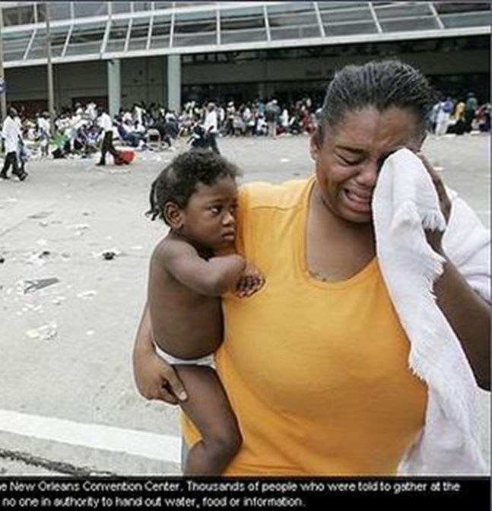
Lessons-Learned: National Failures in Preparedness for Vulnerable Communities
Hurricane Katrina (2005): A National Example
Evacuation Failures: Low-income, African American residents were unable to evacuate due to lack of transportation and resources.
Communication Barriers: Non-English-speaking communities were unable to access critical emergency information.
Disproportionate Impact: Vulnerable populations (e.g., elderly, disabled) were trapped in homes without adequate shelter or medical care.
Notes:
Let’s go big-picture for a moment. Hurricane Katrina is a painful but powerful example. Evacuation efforts failed, and it wasn’t because people didn’t care—it was because systems weren’t built to support those without money, cars, or access to timely info. Whole neighborhoods were left behind—predominantly low-income, Black, elderly, or disabled residents. Language barriers, lack of access to transportation, and no emergency plans that accounted for them. We can’t afford to repeat these mistakes—so as we move forward, let’s keep asking: Are we building systems that include everyone?

Slide 10
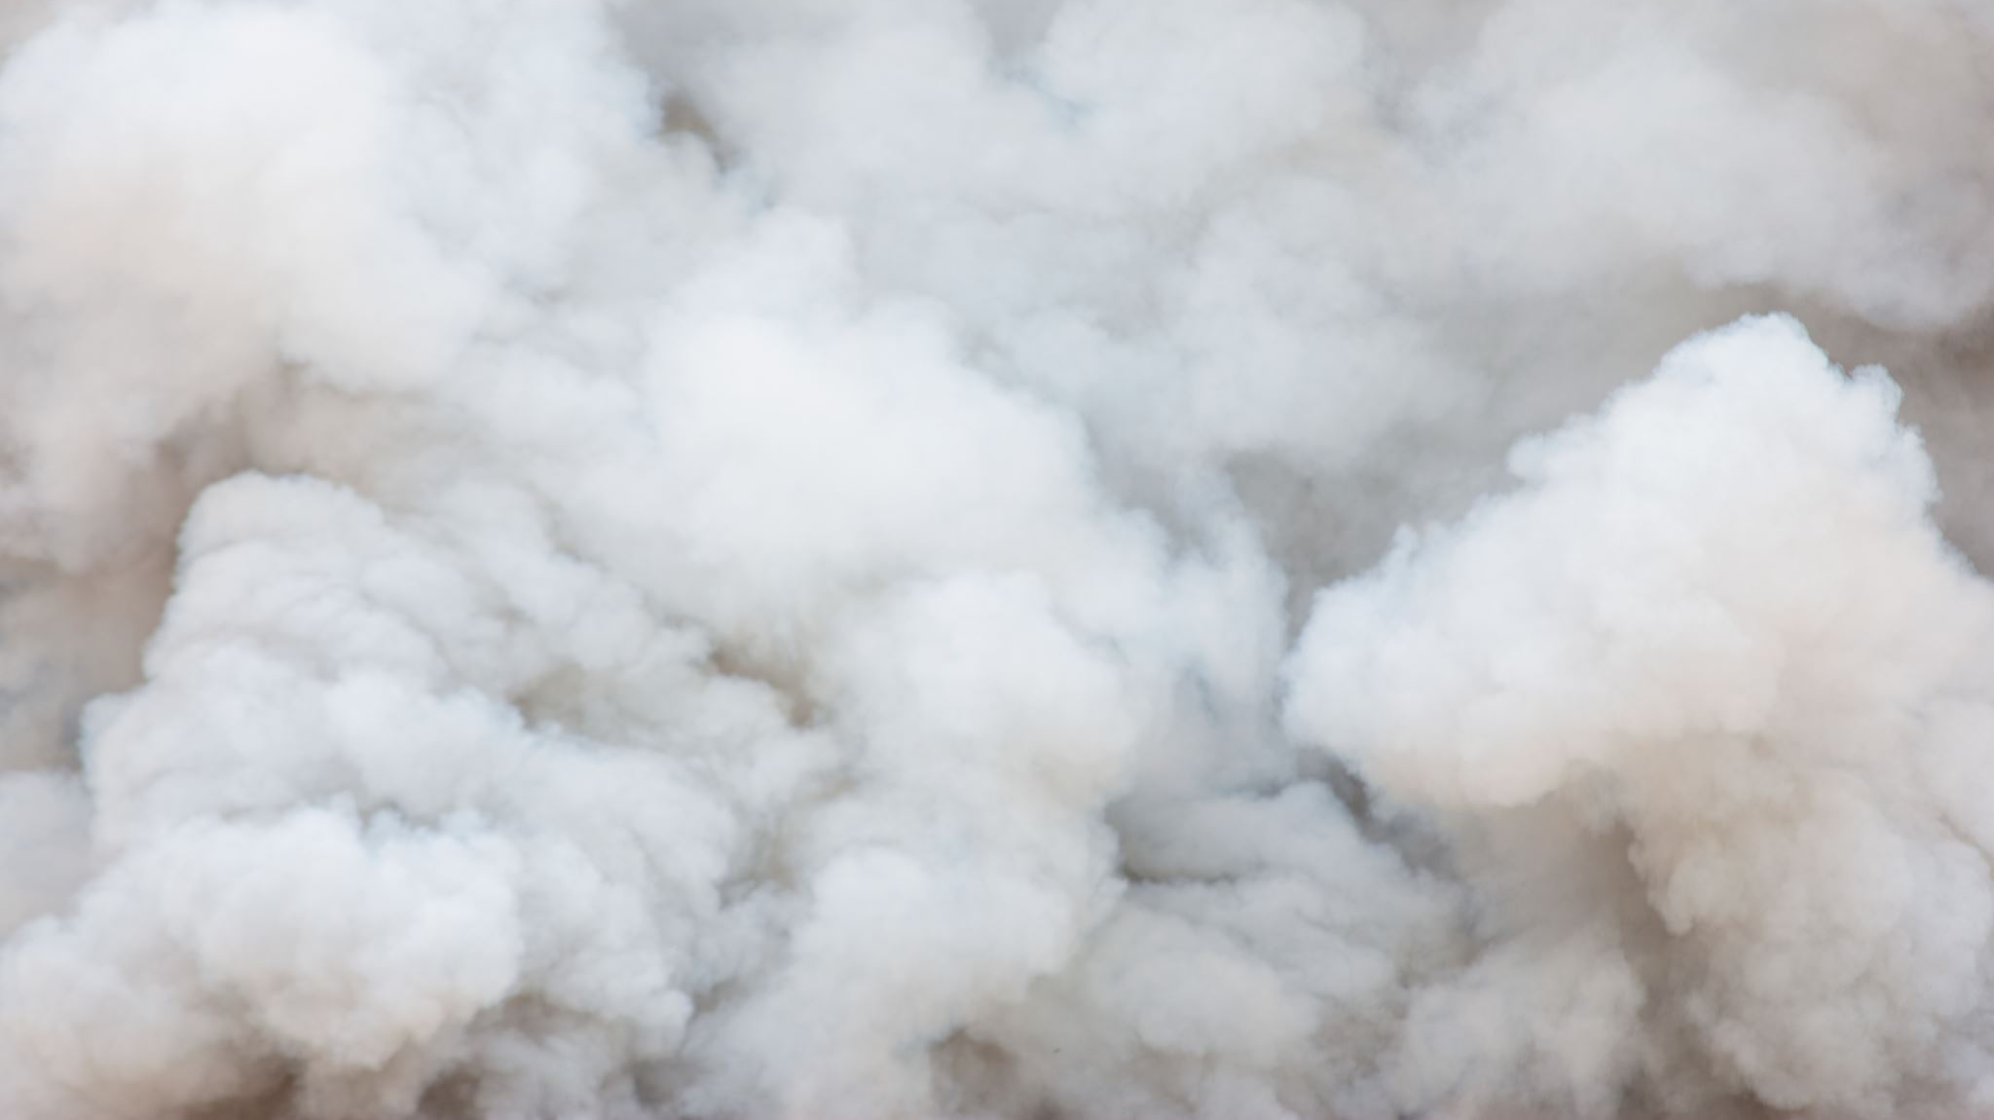
LOCAL FAILURES AND THEIR IMPACT ON VULNERABLE COMMUNITIES
Valley Fire (2015, Lake County):
Over 1,300 homes destroyed, many uninsured or underinsured, leaving low-income and elderly residents unable to rebuild.
Rural residents faced evacuation challenges due to lack of transportation and inadequate preparedness plans for vulnerable groups.
Limited cell service hindered timely evacuation orders, especially for non-English-speaking residents.
Paradise Camp Fire (2018):
95% of Paradise destroyed, including over 19,000 homes and businesses; 96% of mobile homes (housing low-income retirees) were lost.
Rebuilding efforts are slow, with few affordable housing options, making recovery difficult for low-income and elderly residents.
Notes:
Closer to home, we saw similar breakdowns during the Valley Fire and the Camp Fire. The Valley Fire devastated communities in Lake County—many homes lost were uninsured, and rural evacuation routes were clogged or confusing. Cell service failed. People were trapped. During the Camp Fire in Paradise, low-income mobile home communities were wiped out. Seniors had nowhere to go. And now, years later, many haven’t been able to rebuild. These aren’t just stories—they’re warnings. If we want to be ready, we have to learn from what didn’t work and build from the ground up, starting with our most vulnerable.

Slide 11
What we’ve learned about vulnerable communities and inclusive preparedness
Engage Vulnerable Populations in Planning
01
Multiple Emergency Communication Methods
02
Transportation, Evac. Routes
03
Affordable Housing/ Policy to Support Recovery
04
Notes:
So what have we learned? First: Plans must be localized. Every community has different needs and populations, and cookie-cutter approaches don’t cut it. Second: Communication must be layered—text alerts, radio, door-to-door, Spanish-language materials, cultural ambassadors. In Ukiah, we've started handing out bilingual emergency sign-up cards at events and even grocery stores. And third: Recovery isn’t just about rebuilding—it’s about reconnecting people to support systems, housing, and hope. Inclusive preparedness isn’t charity—it’s strategy. Because the better we protect our most vulnerable, the stronger we all become.

Slide 12
Notes:
This is where the real work begins—engaging people who don’t usually show up to planning meetings. In Ukiah, we’ve learned that if we want diverse voices at the table, we can’t just invite them—we have to go to their tables. That might mean churches, schools, swap meets, or community dinners. One tool we’ve used is recruiting community ambassadors—people who already have trust and relationships with those groups. They help translate—not just language, but systems. And we’ve made it easier for people to get involved—offering childcare during training, serving food, and even providing interpretation and transportation when we can. What’s one thing you could change about how you engage vulnerable groups in your own community? Write it down or share it with someone at your table—we’ll come back to this.

Slide 14
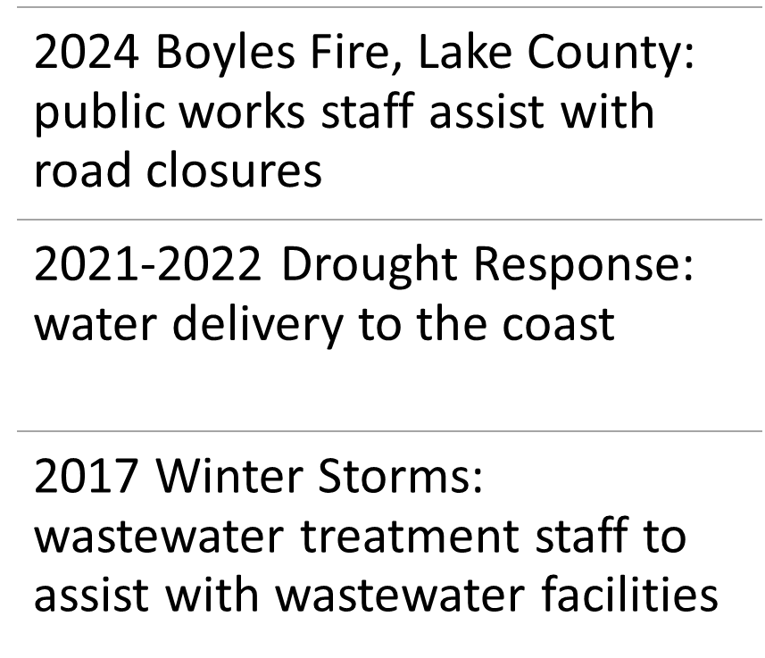
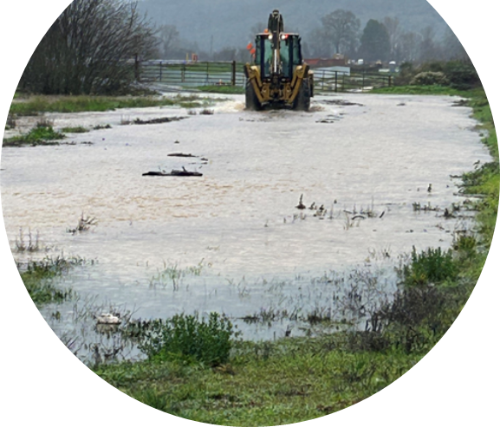
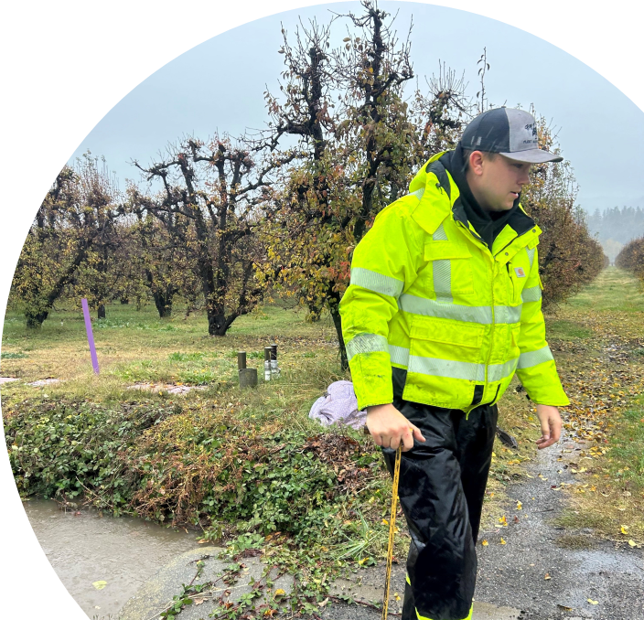
Resource sharing through MOUs and MOAs
Notes:
“You’ll notice some Lifesavers on your tables—those weren’t just a sugar boost. Think about who your lifesavers are in your community. Who shows up during an emergency? Who do your vulnerable populations rely on? Who could you create a partnership with now—before disaster strikes? Take a moment to think of someone who has been a lifesaver in your own work. And if you're feeling bold, pass a Lifesaver to someone at your table and let them know: 'You're a lifesaver because…' That’s the kind of connection we need more of in our planning and our partnerships.”

Slide 15
AI- Your Co-Pilot for Emergency Management
ChatGPT
Translate messages
Create training plans
Summarize after-action reports
Brainstorm inclusive outreach ideas
Notes:
“Write an emergency alert message for a boil water notice in both English and Spanish.” → Display result
Bonus: Ask ChatGPT for a preparedness checklist for people without a car
“Write an emergency alert message for a boil water notice in both English and Spanish.” → Display result
Bonus: Ask ChatGPT for a preparedness checklist for people without a car
Message: You don’t need to be a tech expert to use this tool!

Slide 16
Direct Approach to Solutions
Step One: Write it Down (5 mins)
Yellow Sticky: "I need help with..."
Blue Sticky: "I can offer help on..."

Slide 17
Direct Approach to Solutions
Step Two: Find Your Match (10 mins)
Find a person in the room with the opposite color Post it
If they match your challenge, great, if not, just start a conversation and share resources and challenges
No Match – No problem. Place your sticky on the connection board at the back of the room for follow-up.
Notes:
Now that we’ve had a chance to connect challenges and resources, I want to give you a minute to reflect. Grab one of the little paper airplanes on your table. On the wing or tail, write down one idea or insight you’re taking away from this session today—something you're going to take back to your team, or just something that inspired you. Once you're done, we’re going to gently launch them toward the front. No high-speed disasters—just an intentional little flight of your ideas. We’ll pick a few and read them aloud to see where our ideas are headed.”

Slide 18
Key Takeaways & Actionable Strategies
Develop inclusive preparedness plans
Use innovative tools to improve communication and training
Establish resource-sharing models (MOUs) for emergency response
Mobilize diverse populations through innovate tools to engage whole community

Slide 19
Final Approach: Q&A and Discussion

Slide 20
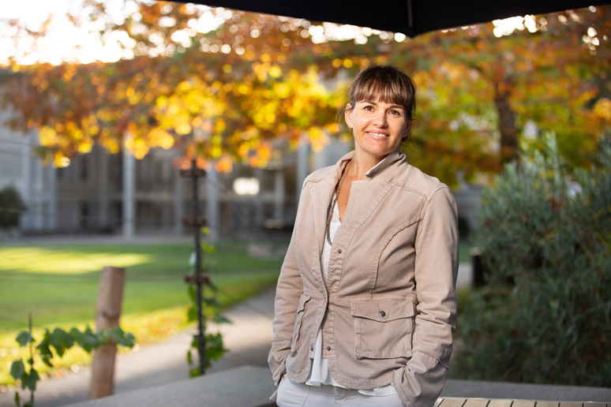
Traci Boyl tboyl@cityofukiah.com 707-467-5720
Thank You!

